Slide 1
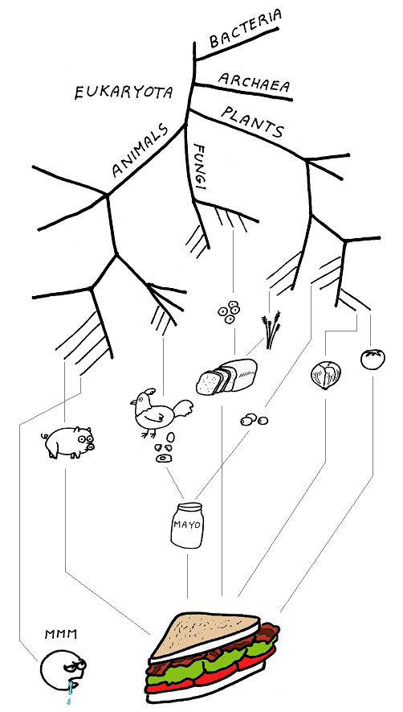
The evolution of Stress induced mutation
Yoav ram
Hadany Lab
Life sciences faculty
Tel-aviv University
11 June 2014

Slide 2



Variability in mutation rates
Between species
Average # of mutations per genome per generation
Flies: 0.455
Keightley et al. Gen Res 2009
Humans: 41
Lynch, PNAS 2010
Bacteria: 0.0004
Wielgoss et al. G3 2011
2

Slide 3

Variability in mutation rates
Within species
Mutation rate in 69 natural populations of E. coli Matic et al. 1997

Slide 4

Variability in mutation rates
Q: Why so many polymerases?
Within individuals
DNA polymerase error rate Lynch 2011

Slide 5

Stress-induced mutation
Rosenberg et al. 2012
In E. coli:
Error prone polymerase induced by stress responses:
SOS response
DNA damage
Starvation
Mismatch repair system
Other mechanisms:
Galhardo et al. 2007
Al Mamun, Science 2012

Slide 6

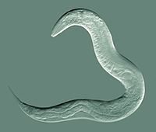
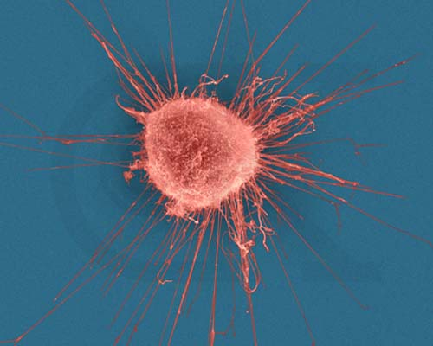



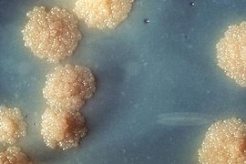

Evidence
Green algea
Nematodes
E. coli
Bacillus subtilis
Breast cancer cell
D. Melanogaster
M. tuberculosis
L. monocytogenes

Slide 7
Consequences of stress-induced mutation
Q: How does SIM affect evolution?
Focus: Adaptive Peak Shift

Slide 8
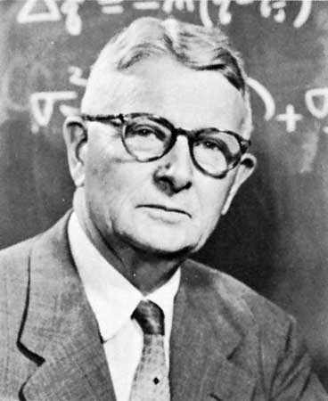
Adaptive peak shifts
This problem was introduces by Sewall Wright in 1931:
If a new adaptation requires several, separately deleterious mutations, how can it evolve?

Slide 9
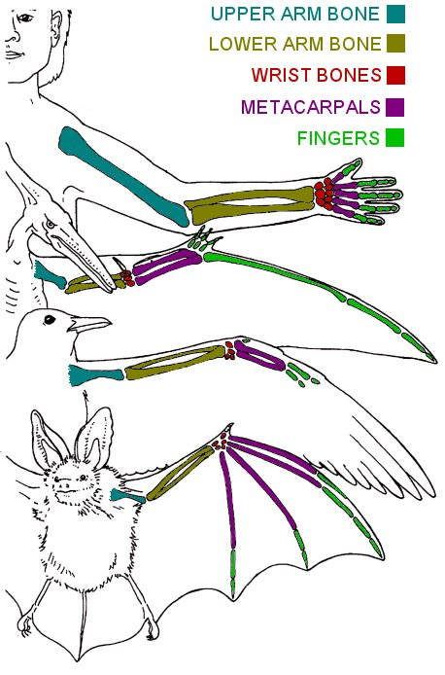
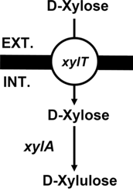
examples
Criteria
Adaptation requires a change in two or more traits
Change in only one trait causes reduced fitness
Wings and bones
Flying with heavy bones is costly
Walking and climbing with light bones is dangerous
New metabolic pathway
Two new proteins required – pump and enzyme
each is wasteful without the other
Adaptation to high UV (Haldane 1932, p. 175)
Dark skin – increased pigmentation
Vitamin D storage in the liver
Xiao et al. 2011

Slide 10

Simple landscape

Slide 11


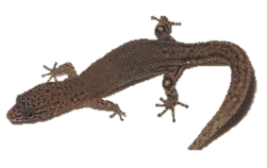

Rugged landscape
Wings
Light bones
No wings
Heavy bones
No wings
Light bones

Slide 12
Adaptive Peak shift
High peak
Low peak
Valley

Slide 13
SIM & rugged landscape
Increasing the mutation rate in individuals below both peaks
High mutation rate
Low mutation rate

Slide 14
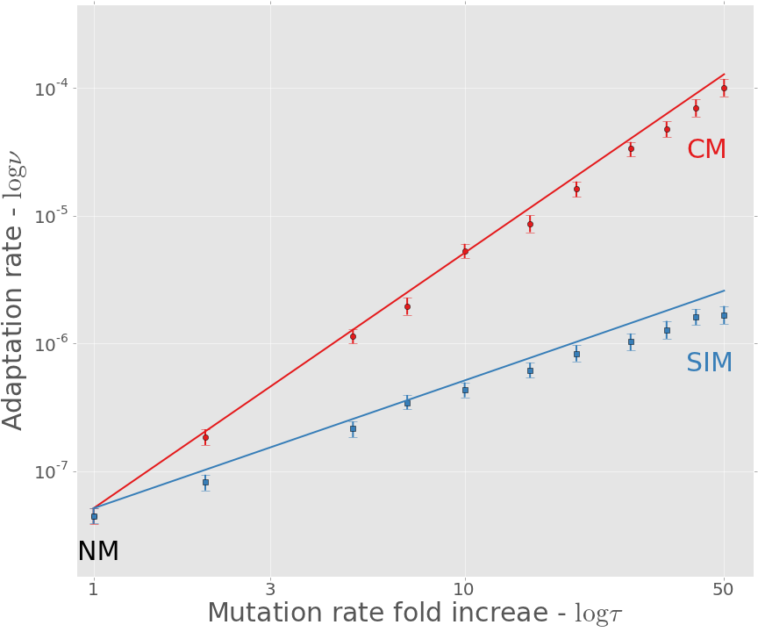
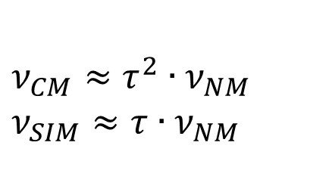
Adaptation rate CM: constitutive mutation SIM: stress-induced mutation
$$ν_{CM}≈τ^{2}∙ν_{NM}$$
$$ν_{SIM}≈τ∙ν_{NM}$$
Approximation
Simulation

Slide 15
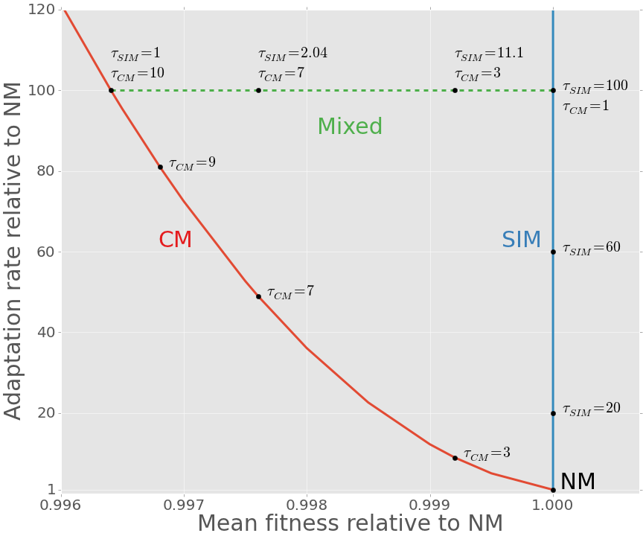
Evolutionary efficiency: SIM is more efficient than CM
Adaptability - Adaptation rate relative to NM
Adaptedness - Mean fitness relative to NM (non-mutator)

Slide 16


Conclusion
Stress-induced mutation increases the adaptation rate without reducing the population mean fitness
Stress-induced mutation is an efficient evolutionary strategy
Lilach Hadany
Uri Obolski
Ariel Guiejman
Eyal Zinger
Acknowledgments
Amalia Biron-Zigle Foundation

